Slide 1
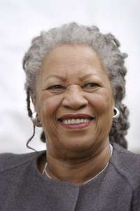
Toni Morrison
Nobel Prize Winner, 1993

Slide 2
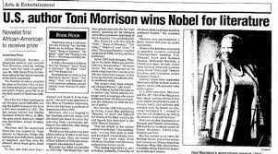
https://www.washingtonpost.com/archive/politics/1993/10/08/author-toni-morrison-wins-nobel-prize/6077f17d-d7b7-49a3-ad90-8111cf8478d1/

Slide 3

https://www.nobelprize.org/prizes/literature/1993/morrison/facts/

Slide 4
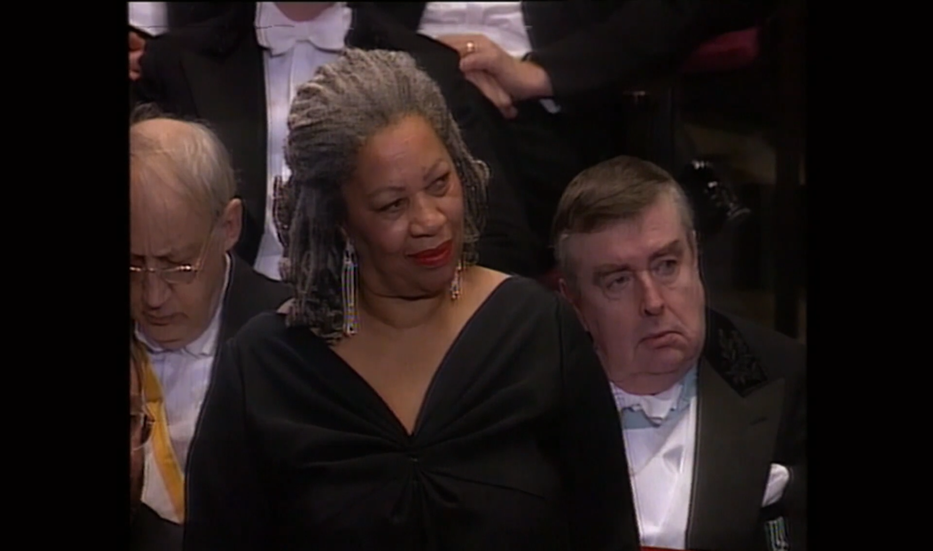
https://www.nobelprize.org/prizes/literature/1993/morrison/facts/

Slide 5
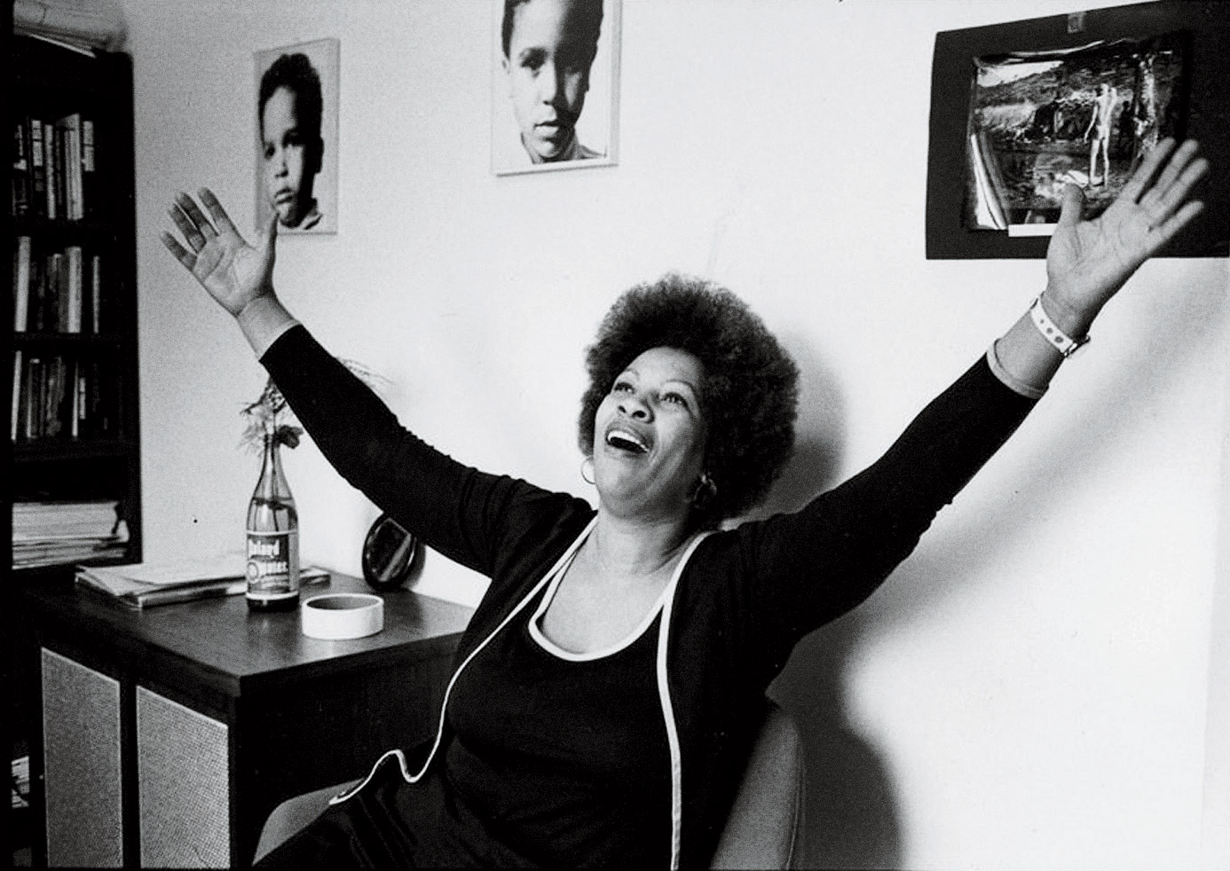
https://www.womenshistory.org/education-resources/biographies/toni-morrison

Slide 6
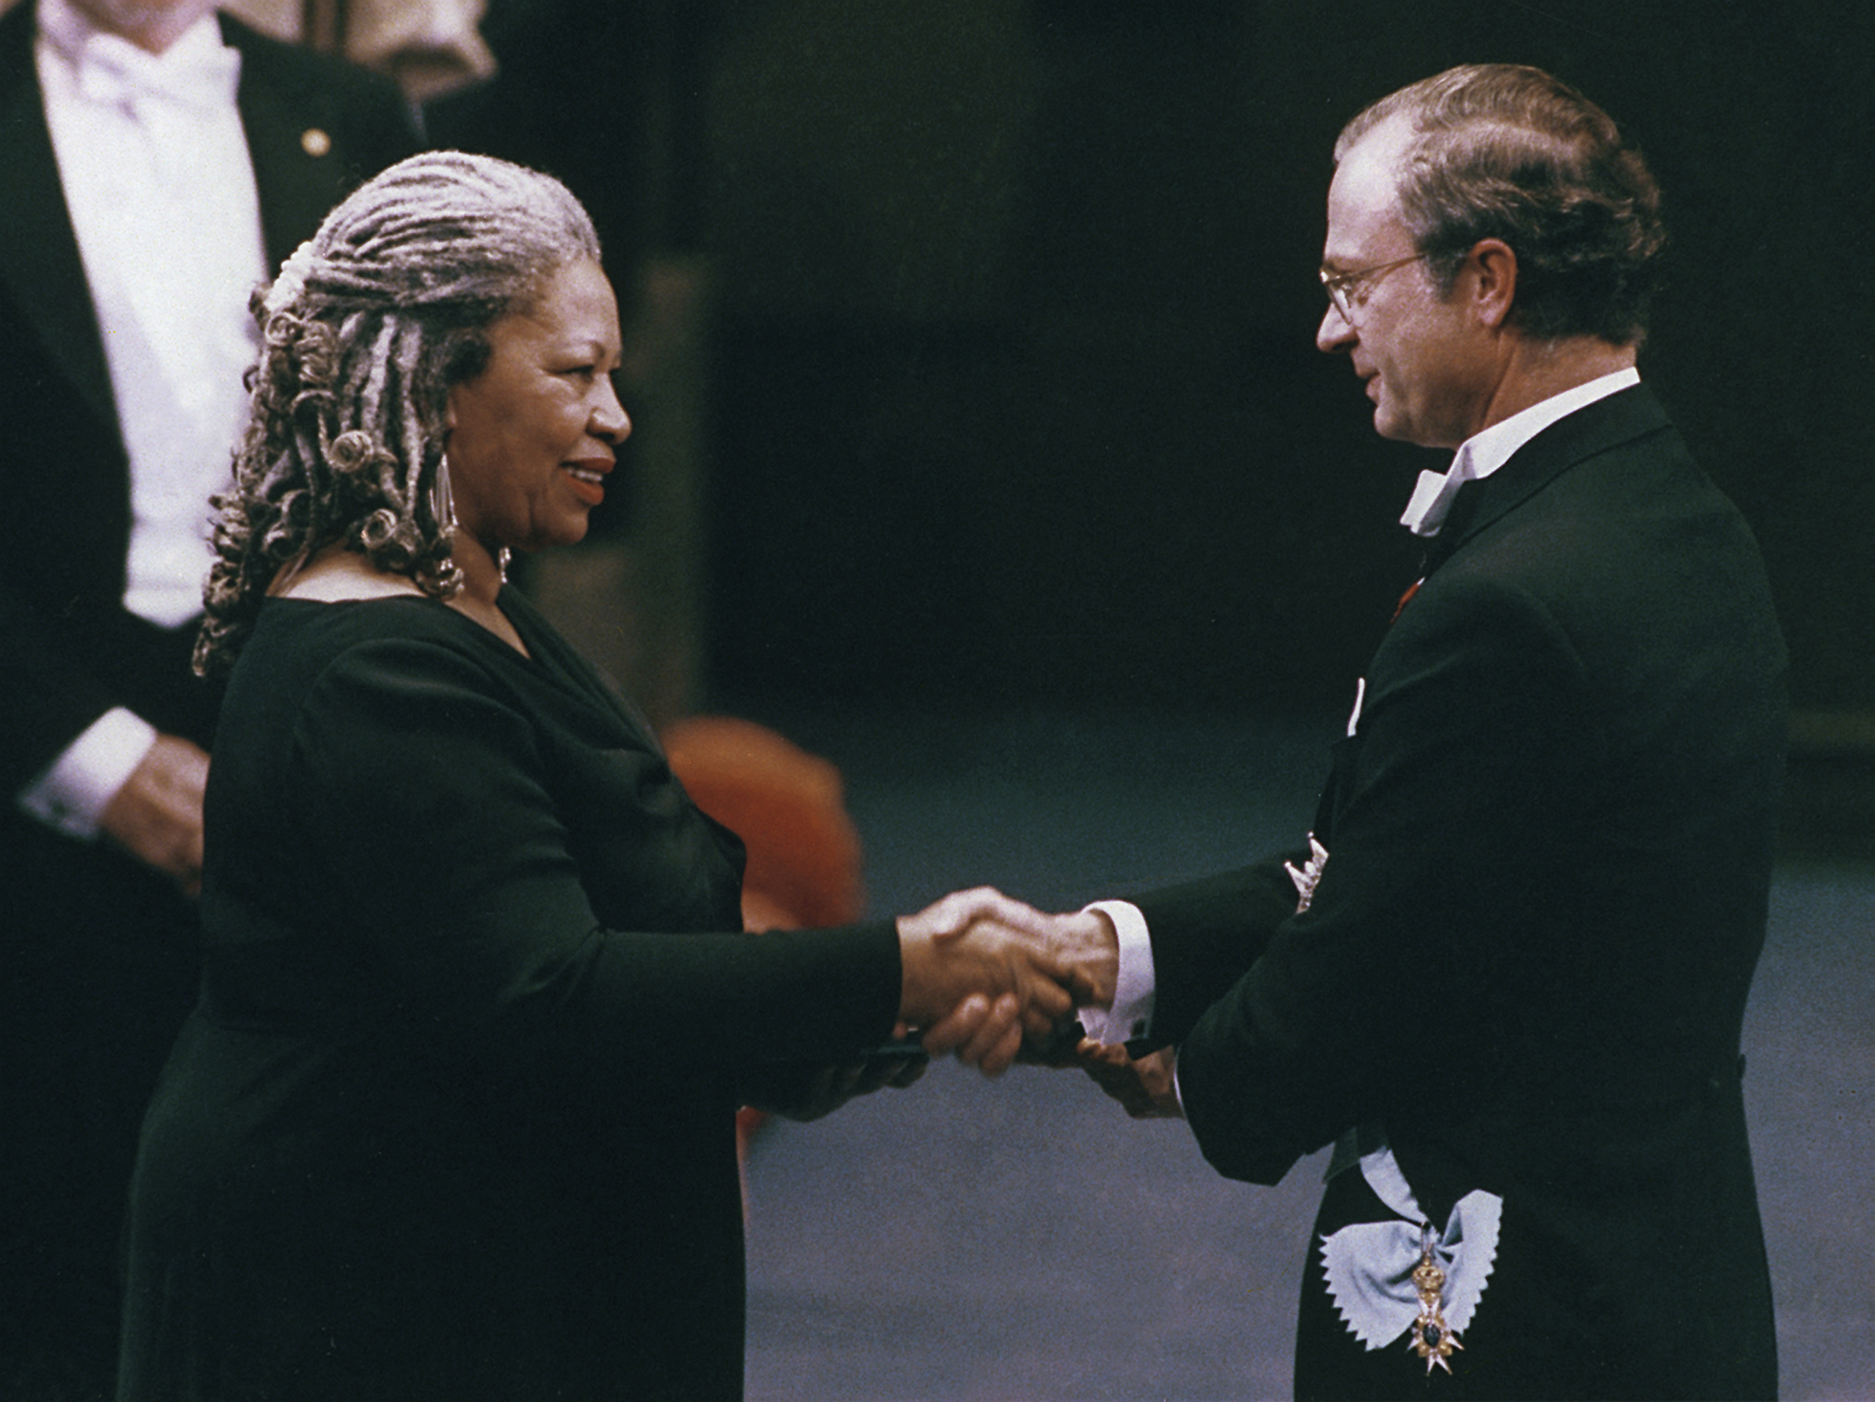
https://www.womenshistory.org/education-resources/biographies/toni-morrison

Slide 7
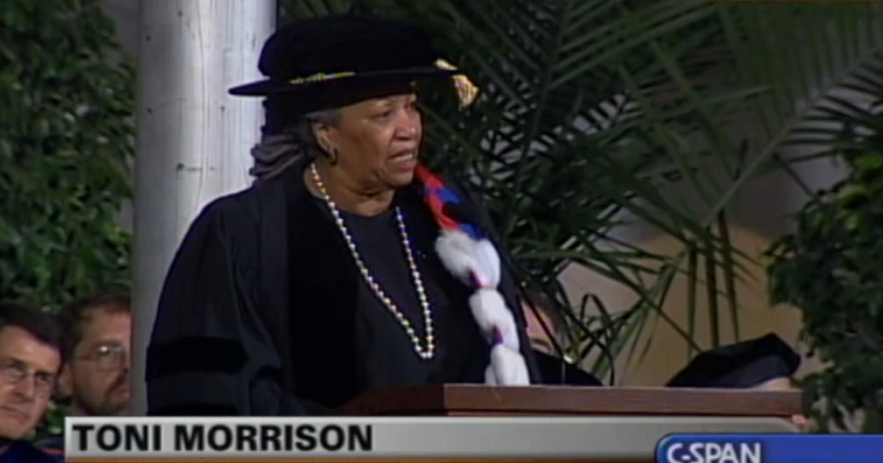
https://youtu.be/N4MwmayLwXo

